Slide 1
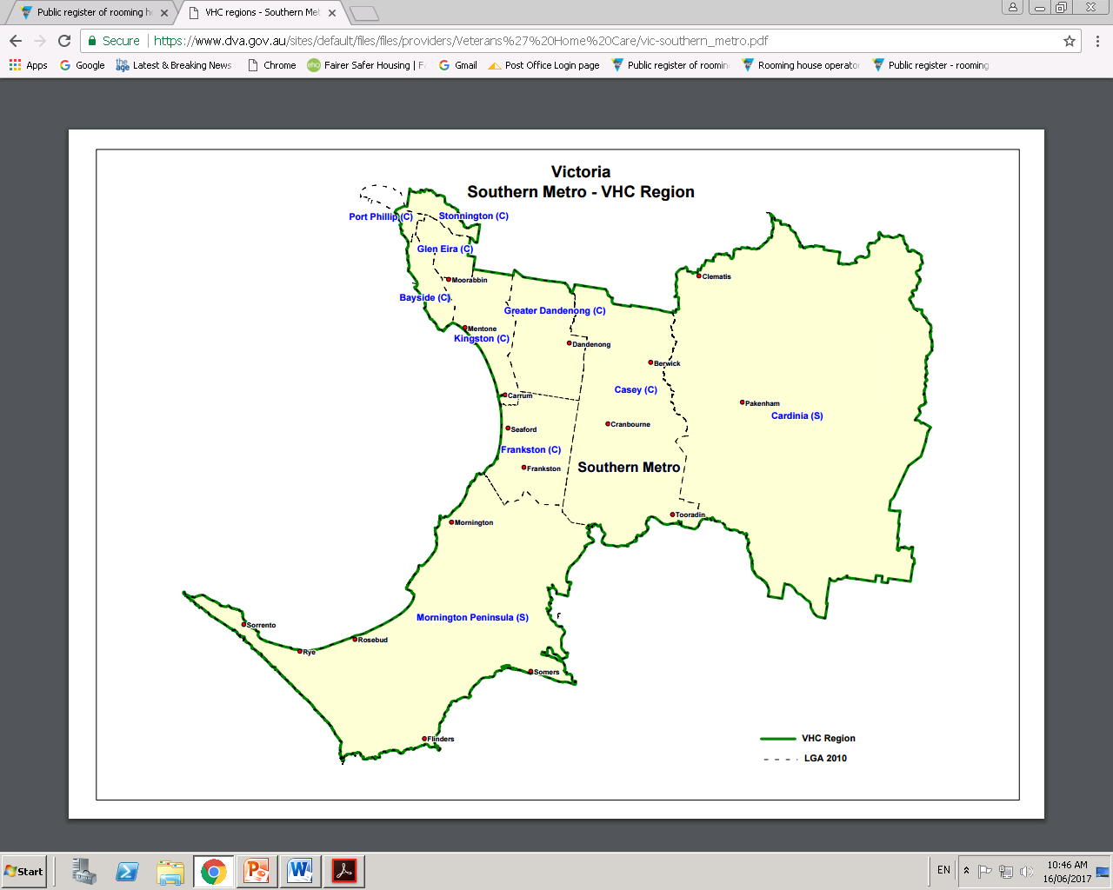

ALDO TARANTO
PENINSULA
COMMUNITY LEGAL
CENTRE
SUPPORT FOR SINGLE PEOPLE LIVING IN PRIVATE ROOMING HOUSES
Over 800 registered rooming houses
17 Local Government Areas
South East
Region
Program objectives: contact maximum number of residents, identify inappropriate housing, reconnect to health and support services, offer Residential Tenancies advice, report breaches.
24 month funded program to June 2019.
Bayside
Boroondara
Cardinia
Casey
Frankston
Glen Eira
Greater Dandenong
Kingston
Knox
Manningham
Maroondah
Mornington Peninsula
Knox
Port Phillip
Stonnington
Whitehorse
Yarra Ranges

Slide 2










“ A rooming house is a building where:
one or more rooms are available for rent
and
the total number of people who may occupy those rooms is four or more.”
residents share common areas
the owner generally doesn’t live on premises
separate rental agreements may exist
What is a
Rooming House?
Community partnerships
and relationships
Partnerships: enable PCLC to proactively engage and respond to the multiple needs of our client group – single persons living in rooming houses.
Relationships: connect, participate, contribute and collaborate with numerous networks.
310
413
125
33
38
rooming house visits including
multiple visits
residents contacted
residents
assisted
more suitable housing
residents
provided RT
legal advice
unregistered rooming houses identified
190
65
5600
6
13
total
rooming house visits
rooming house visits
material aid supplied
rights and duties guides distributed
minimum standards breaches reported to regulators
operator licence breaches reported to regulator

Slide 3
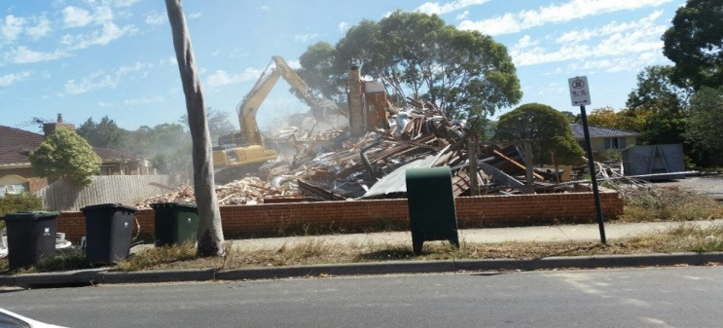
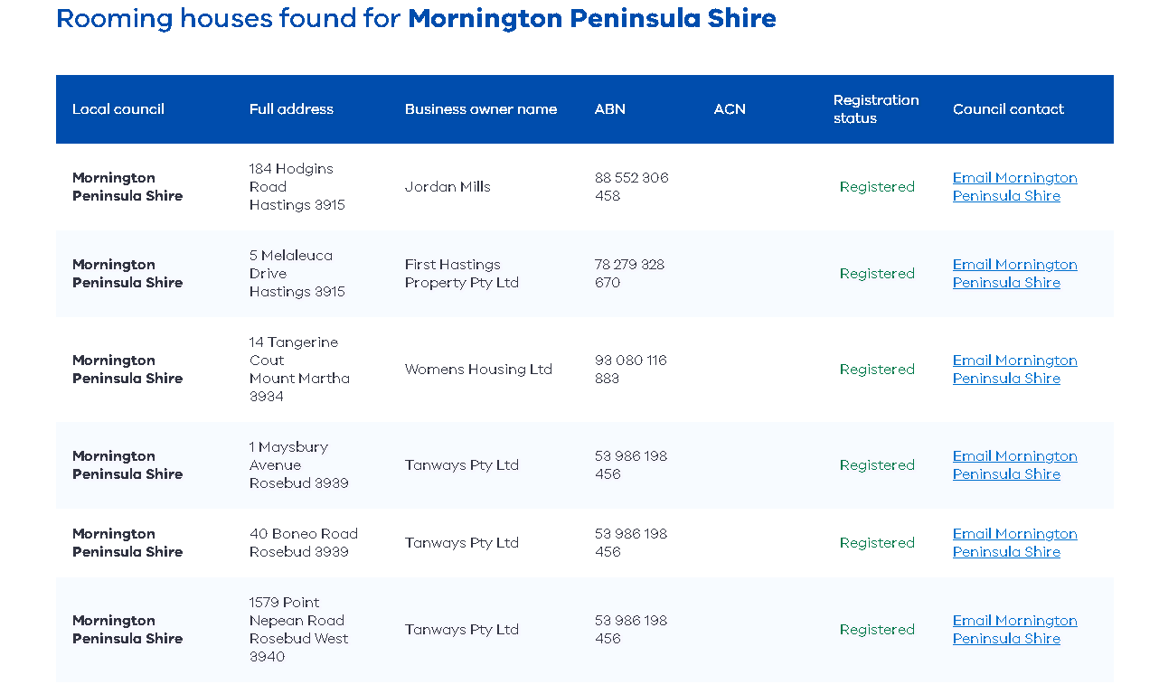
Councils are responsible to upload and maintain an accurate register of rooming houses.
The register is hosted by Consumer Affairs Victoria.
Delays may occur to upload new registrations and cancellation of registrations.
Impacts on the timely support and delivery of outreach services.
Consumer Affairs
Victoria
Public Rooming House Register

Slide 4
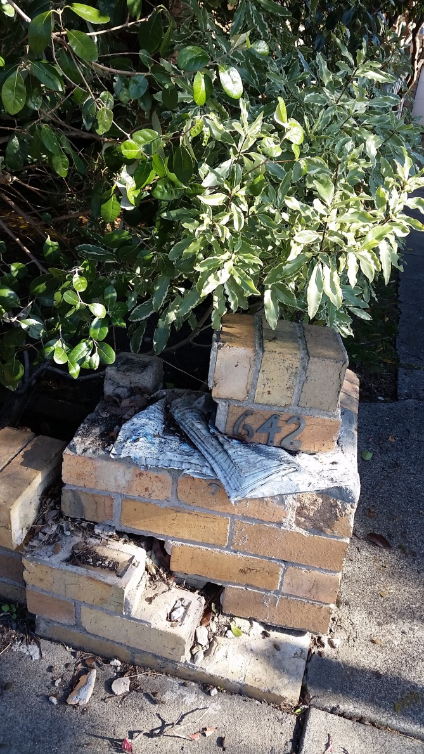
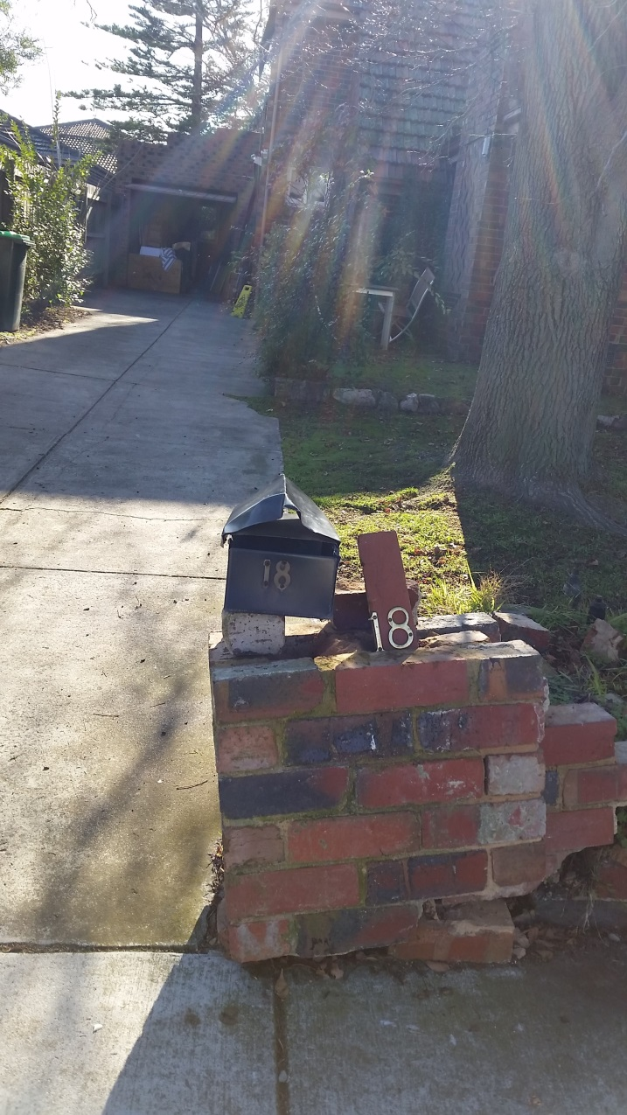

Slide 5
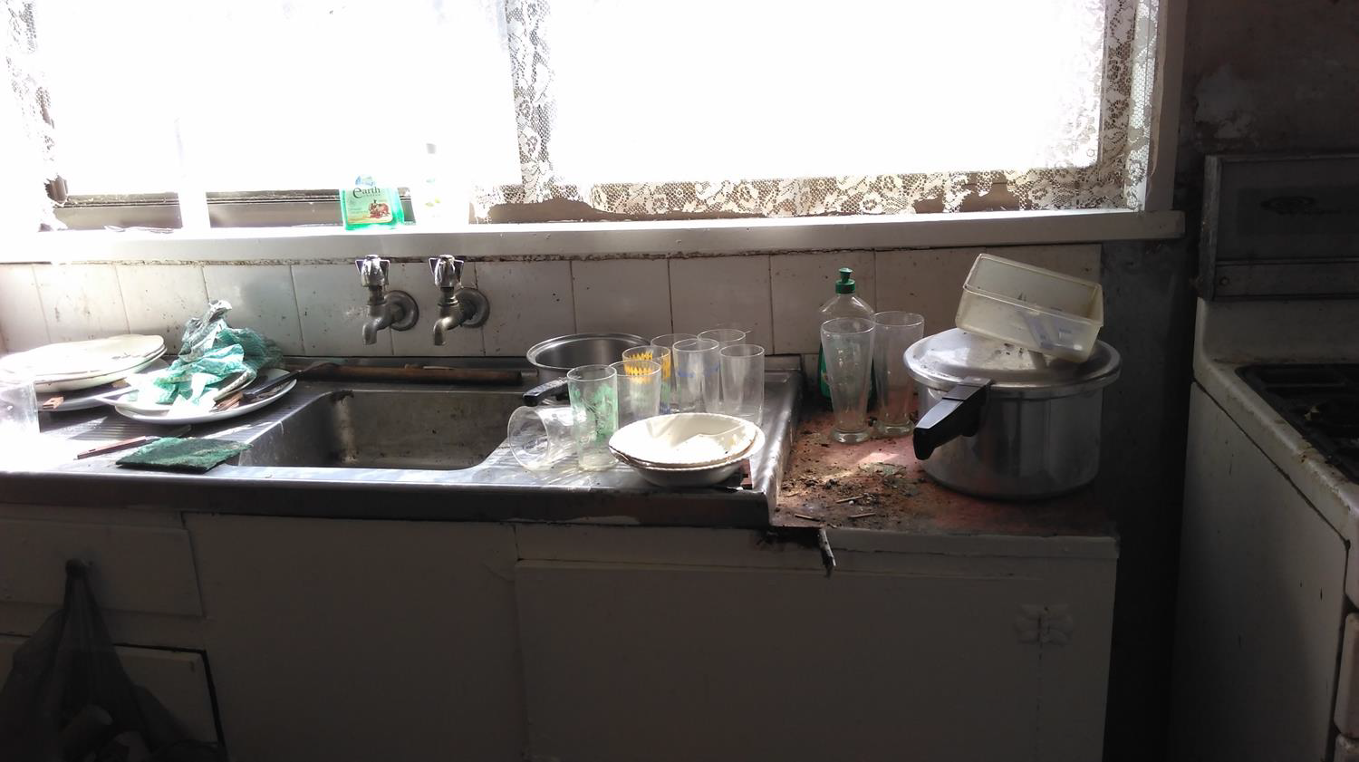
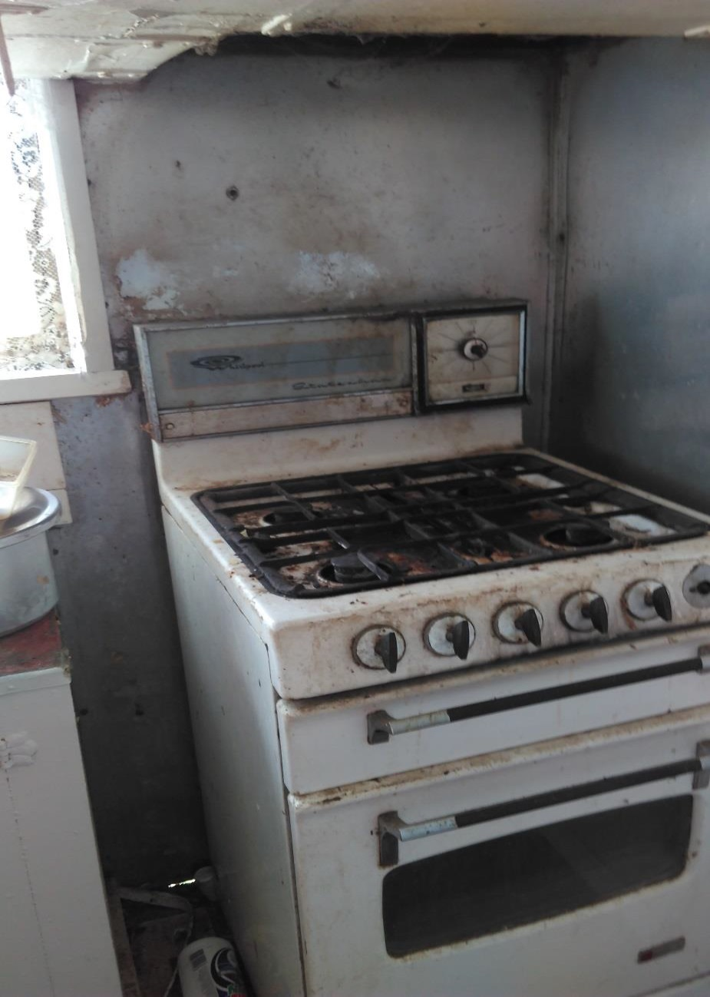

Slide 6
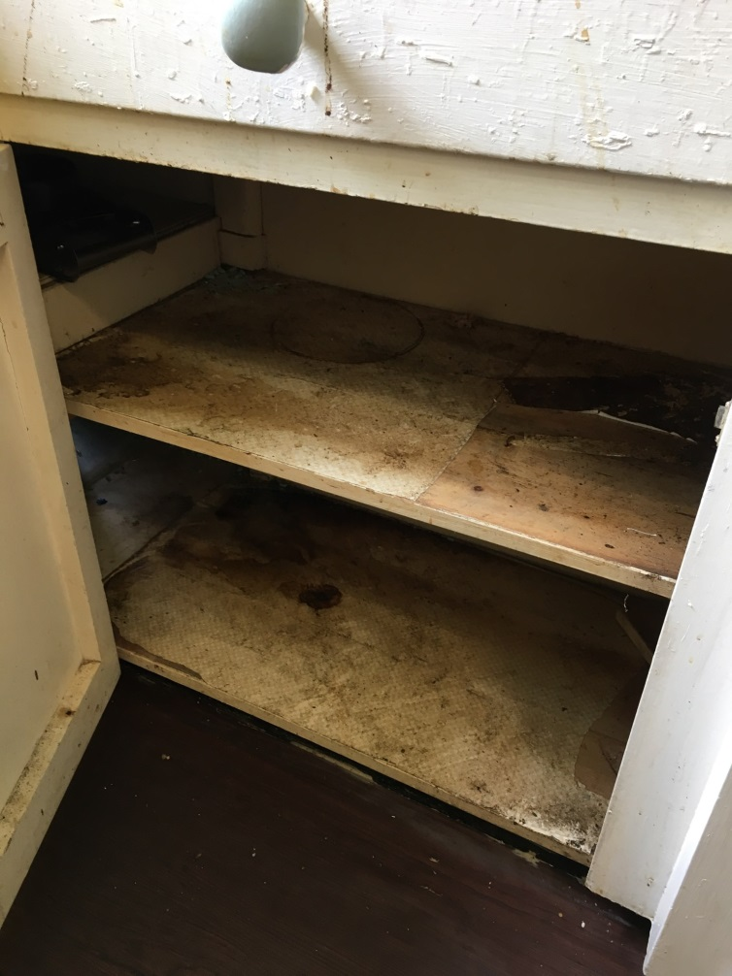
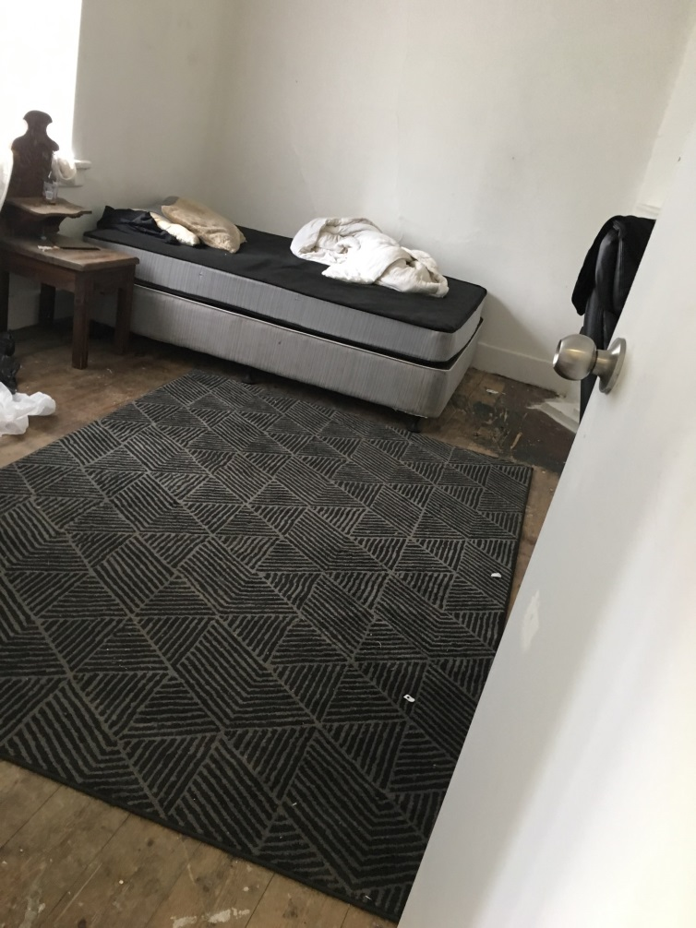

Slide 7
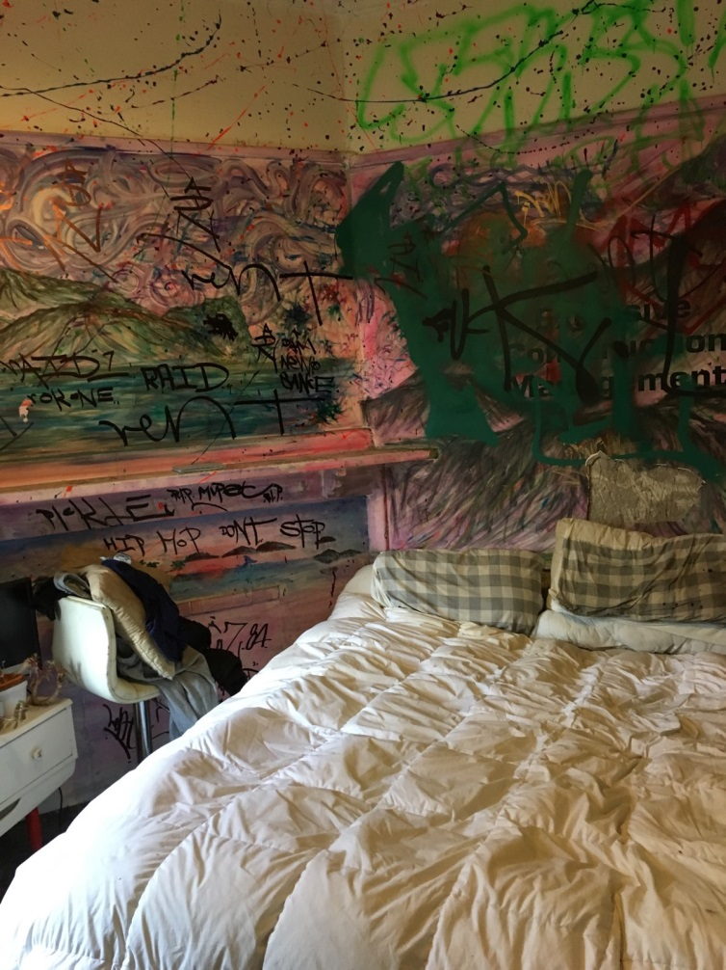
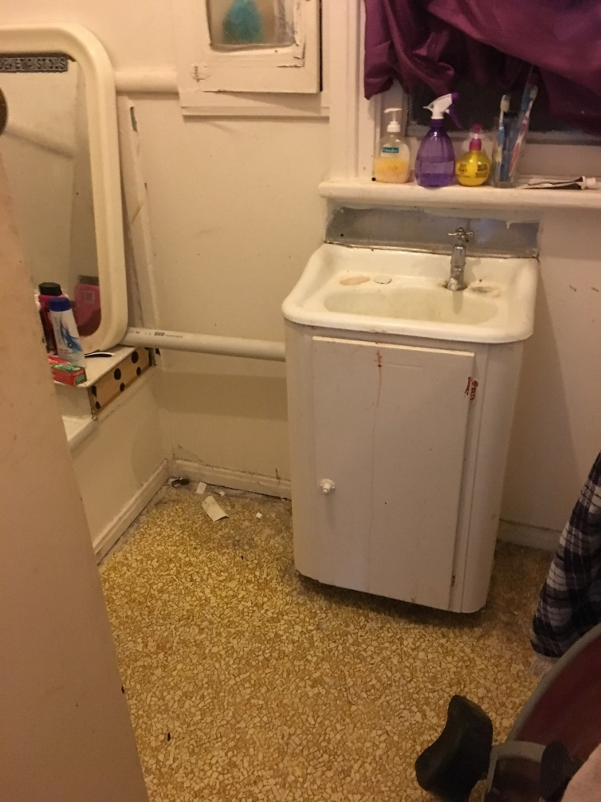

Slide 8
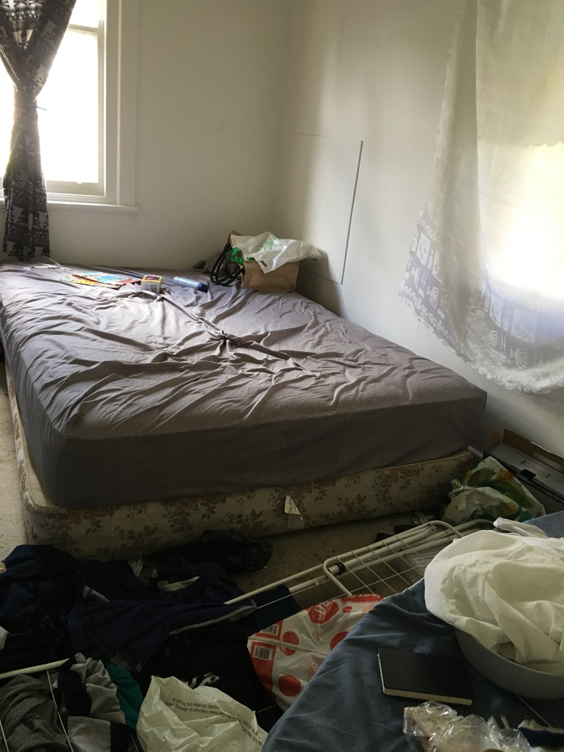
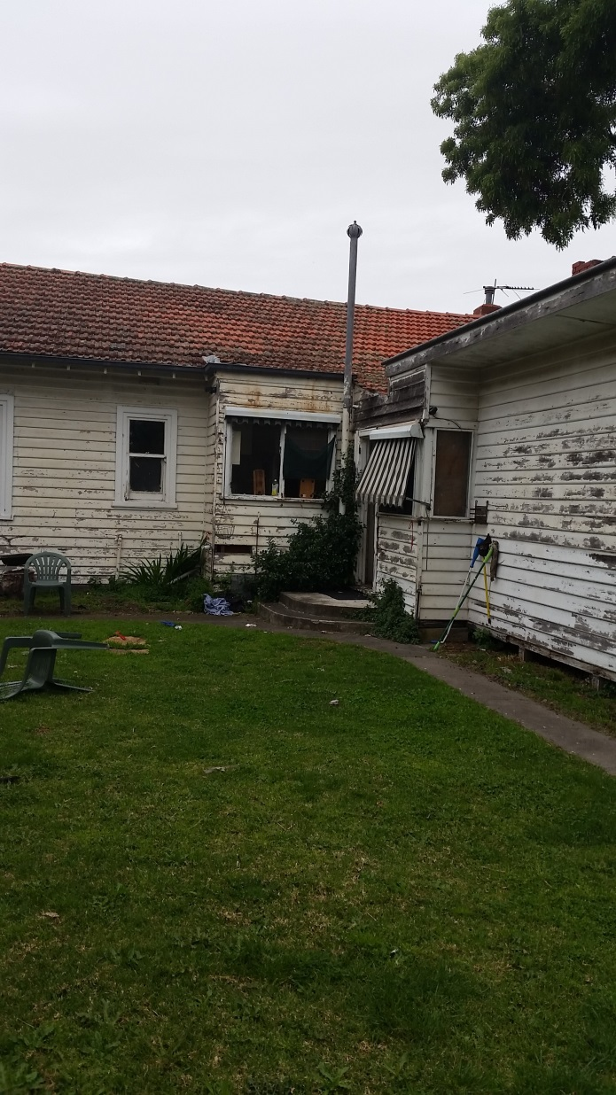

Slide 9
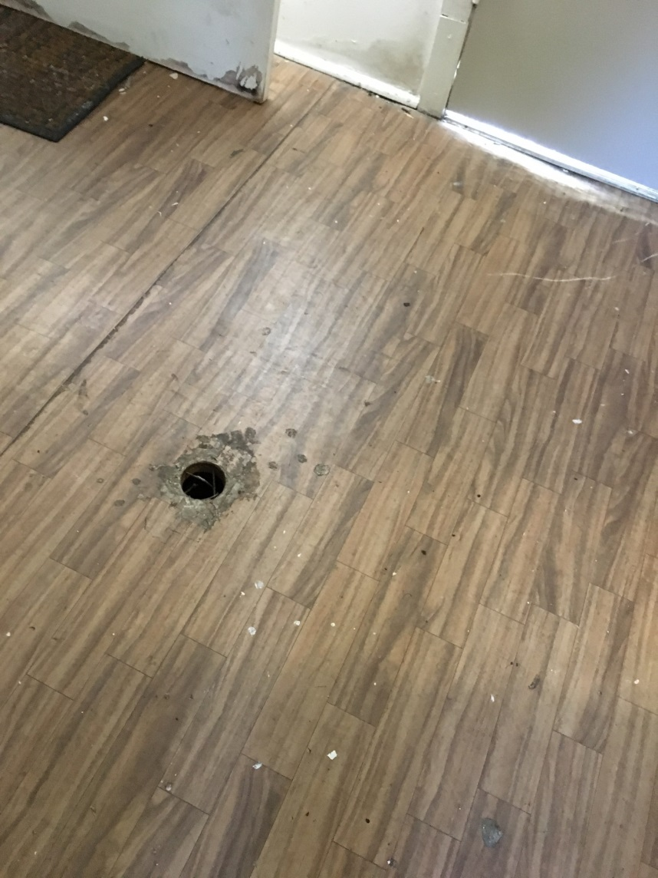
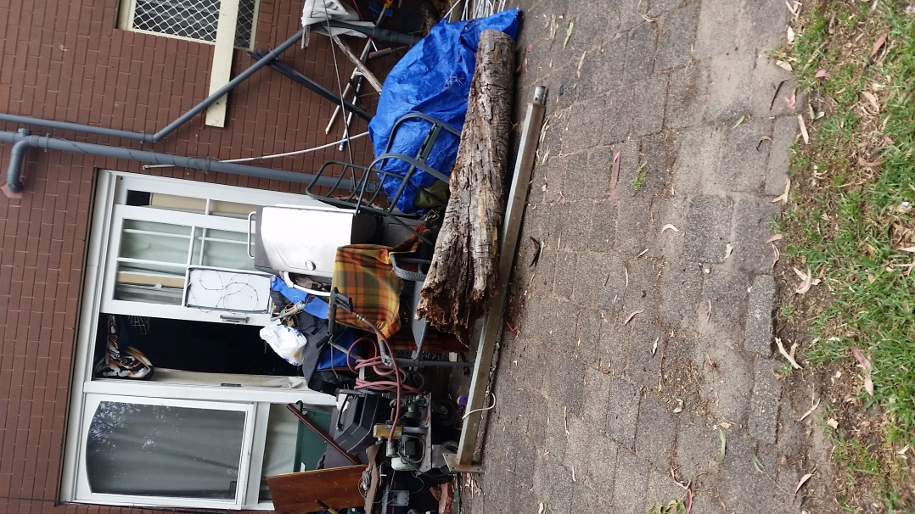

Slide 10
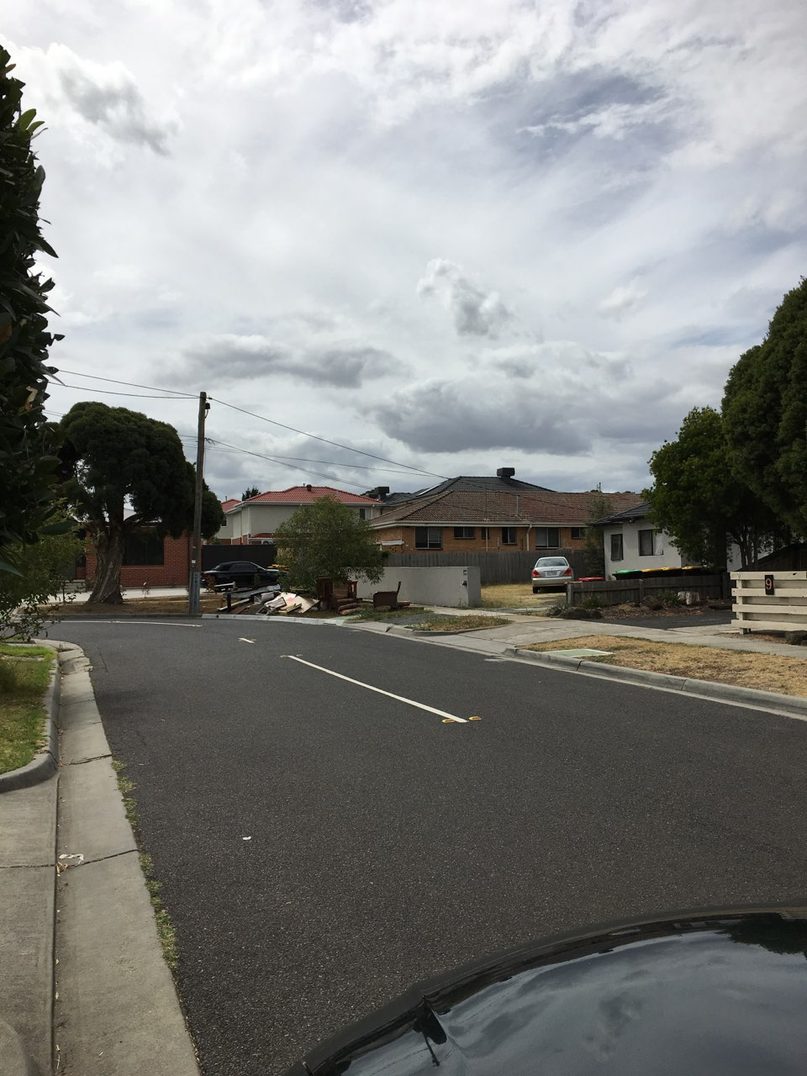
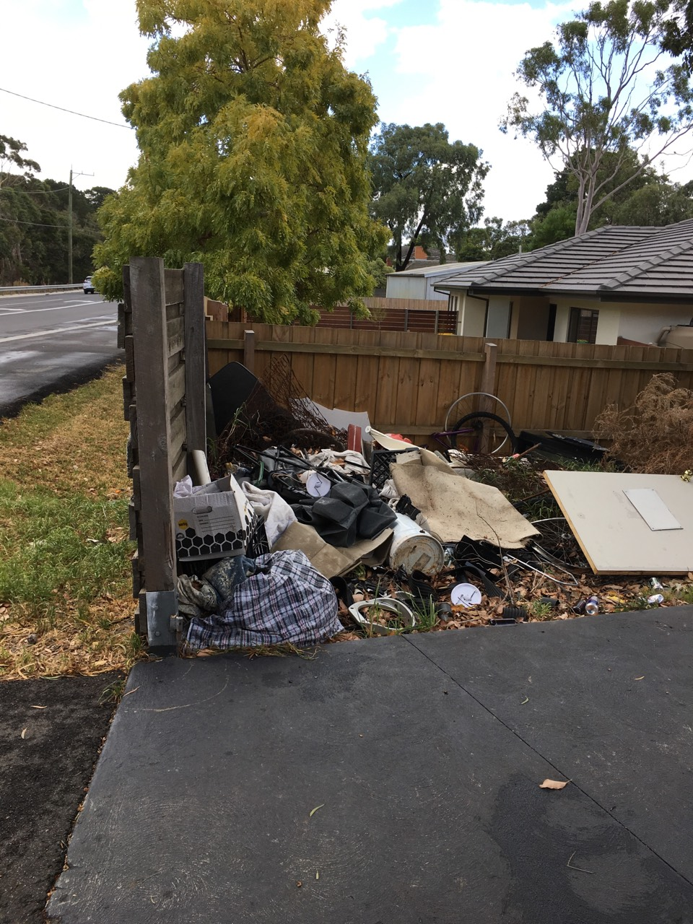

Slide 11
Our Clients: 125 Residents – Housing Assistance
Our findings reveal many residents exhibit signs of anger, agitation and aggression - trauma

Slide 12
October 2017 – December 2018 – Private Rooming House Visitations Data
South East Region:

Slide 13
OPPORTUNITIES -
ROOMING HOUSES
Community Standards
Increase/improve Outreach Services
Attract suitable Operators, including owners
Awareness of High Risk
Environments
Respond to Dietary and Environmental Stresses
Improve opportunity for Housing Agency staff to articulate issues
Improve coordinated activities between regulators
Housing
Agencies
Regulators
Legal
Services
Outreach
Public
Registers
Closer focus by regulator on problem RHO’s
Better match residents with available rooming houses
Legislation
And
Law Reform
Information
And Education
Identify and learn from RHO’s making an effort to support residents
Operators/Owners
Rooming Houses
Unregistered
Registered
Rooming House Outreach Networks
Single mailbox and bathroom in registered rooming houses is a significant oversight
Residential
Tenancies
Commissioner
Property Managers
Improve collection and use of data state of rooming houses
Government
Services
Health
Services
Outreach
Material
Aid
Food Services
Communication with residents post entry into premises
Better informed support workers
Police
Improve awareness of regulators about resident challenges
Request input with new regulations (RT Amendments)
Provide information for operators willing to comply

Slide 14
Let’s Consider “Community Standards”….
“For a substantial number of private rooming house environments to improve and not remain static we need to identify and call out deficiencies with regulations and processes.
Weaknesses result mainly from social change within our communities reducing the suitability of our existing laws, support systems and funding priorities.”
Aldo Taranto
Rooming House Outreach and Support
South East Region

Slide 15
further information…
Email: ataranto@pclc.org.au (Tuesday – Friday)
Telephone: (03) 9783 3600
Website: https://pclc.org.au/
Head Office: 441 Nepean Highway Frankston 3199 - (Monday- Friday, 9am – 5pm)
Office Email: pclc@pclc.org.au

