Slide 1
The Functional Zero approach to ending homelessness
Presenter: George Hatvani
Date: July 24, 2019

Slide 2
Introduction
George Hatvani
Service Development Manager, Launch Housing

Slide 3
Today’s agenda
To describe the Functional Zero approach
To describe the role of a quality By-Name List and give an example of a scorecard (Port Phillip Zero)
To give you a background to the Australian Alliance to end Homelessness

Slide 4
Ending homelessness
Barriers and opportunities
Highly populated service ‘eco-system’
complex multi-system interactions
Many data systems
Strategic planned approach needed
strategic objective
clear measurable outcomes
measuring apparatus or mechanism
Resources
Leadership
Political will at different levels of Government
Notes:
Mackie et al 2019 Conclusion Mackie, P, Johnsen, S & Wood, J 2019, 'Ending street homelessness: what works and why we don’t do it?', European Journal of Homelessness 13 (1) ISSN 2030-2762 / ISSN 2030-3106 online
There is an opportunity and a need for change in the way rough sleepers are assisted. The study upon which this article is based synthesises the evidence base on what works to meet the housing needs of rough sleepers, and it points towards the key underpinning principles which appear to improve the likelihood of success:
be housing-led,
offer person-centred support and choice,
take swift action,
employ assertive outreach leading to a suitable accommodation offer,
ensure services address wider support needs,
and collaborate effectively between agencies and across sectors.
We recommend that these principles should underpin strategies to address homelessness across the developed world.
However, we also identified seven reasons why those responding to street homelessness so often fail to adopt interventions that work.
If we are to end homelessness then we must address:
the lack of settled accommodation,
funding challenges,
ineffective collaboration and commissioning,
the needs of different subgroups,
ineligibility of some people for publicly funded support,
overly bureaucratic processes,
and perhaps most importantly,
7. a lack of political will at different levels of government.

Slide 5
Strategies
The Road Home (2008)
Turning off the tap
Improving and expanding services (to end homelessness is in the Table of Contents, but not in the body of the report)
Breaking the cycle
Rough Sleeping Action Plan (2018)
Intervene early to prevent homelessness
Provide stable accommodation as soon as possible
Support to maintain the accommodation
An effective and responsive homelessness services system

Slide 6
Ending homelessness
What does the functional zero approach offer?
A refined and aspirational goal of ending homelessness
Clarity about what that means: absolute zero refined to functional zero
Clarity about who it is for: one target group over another for clearly considered reasons, with a willingness to adapt if that reasoning is shown to be incorrect or in need of modification.
A strategic approach to cooperation with a shared method for how to achieve functional zero and a roadmap for implementing the approach

Slide 7
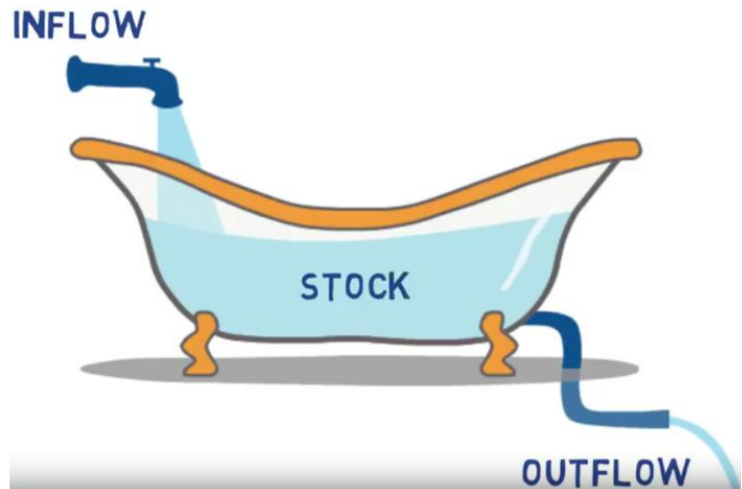
Homelessness over time as a flow
The dynamic view of homelessness

Slide 8
Ending homelessness
Homelessness as a spectrum
Absolute Zero
The complete eradication of homelessness
Functional Zero
Most efficient service system (Housing and supports) possible where the time spent homeless is minimized
Reached when the number of people in the stock and inflow within a month is less than the average monthly placement rate into long-term housing
Needs to be sustained

Slide 9
Why functional and not absolute zero?
Structural and individual reasons why homelessness will continue to occur
Functional zero as an ethical response to a foreseeable problem
Harm Minimization / Harm Reduction
Let’s us work on what we can control, ourselves

Slide 10
Functional Zero: Key elements
1. Collective impact approach (updated in recent times
  Common Agenda/Shared Aspirations
  Shared Measurement as part of overarching strategic learning approach
  Mutually Reinforcing Activities
  Continuous Communication/Authentic Community Engagement
  Backbone Support (Community and Data leads)
2. By Name List
3. Command centre approach to service coordination
  Knowing who is sleeping rough
  Effective coverage of a defined region
4. Continuous Quality Improvement
  Informed by the data, learning and reflecting as we go: system blockages and leverage points identified, responses tried and learnt from
Notes:
Mutually Reinforcing Activities now changed to identifying high value leverage points and possibly loose/tight working relationships: cooperation is not the be all and end all. CI participants must see beyond collaboration and instead focus on strategies that focus on “high leverage” opportunities for change. They must commit to a systemic reading of the complex systems they are trying to change, and to making a realistic assessment of where local actors have the knowledge, networks, and resources to make a difference.

Slide 11
By Name List
Knowing everyone who is sleeping rough in your area
The key data points
Inflow | Active | Outflow
1. New 2. Return from housed 3. Return from inactive | 4. People who were on the list last month and have not been housed. Added to every new period by the people who were ‘new’ or ‘returned’ in the previous period | 5. Housed 6. Inactive (long-term jail or institution or not seen > 90 days) 7. Death
Functional Zero = Inflow + Active < Outflow into Housing

Slide 12
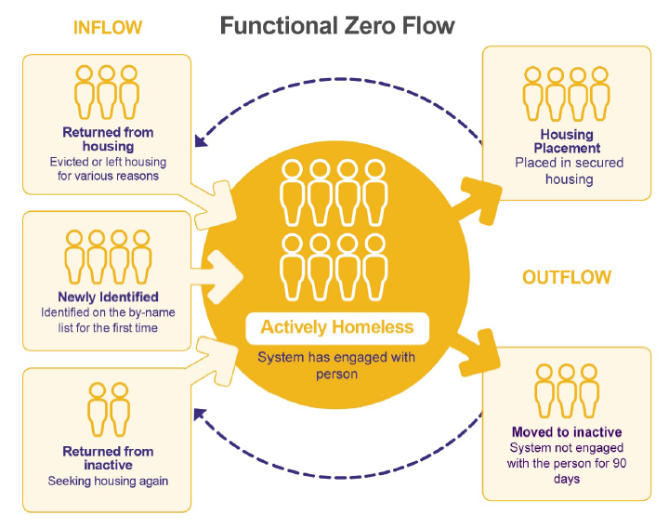
By Name List

Slide 13
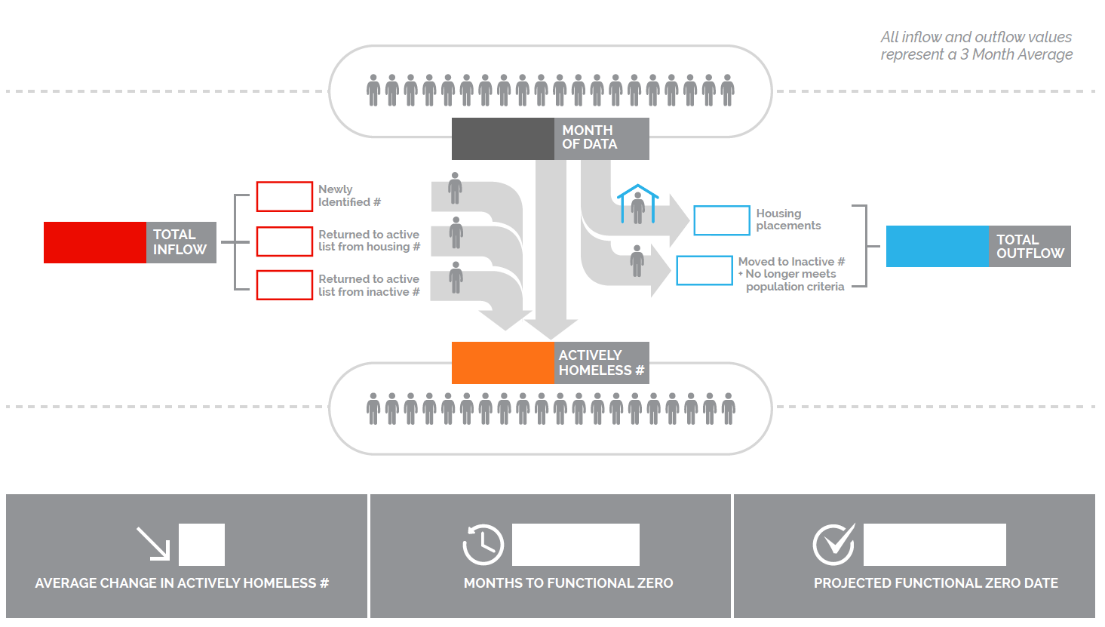
Key Data Points visualized

Slide 14
Port Phillip Zero: BNL #1 July 10, 2019
Inflow
Stock
Outflow
Rough sleeping
New
34
54
Housed
0
Return from Housing
0
Inactive
0
Temporary Shelter
Return from Inactive
0
9
Deceased
0
Actively Homeless
97

Slide 15
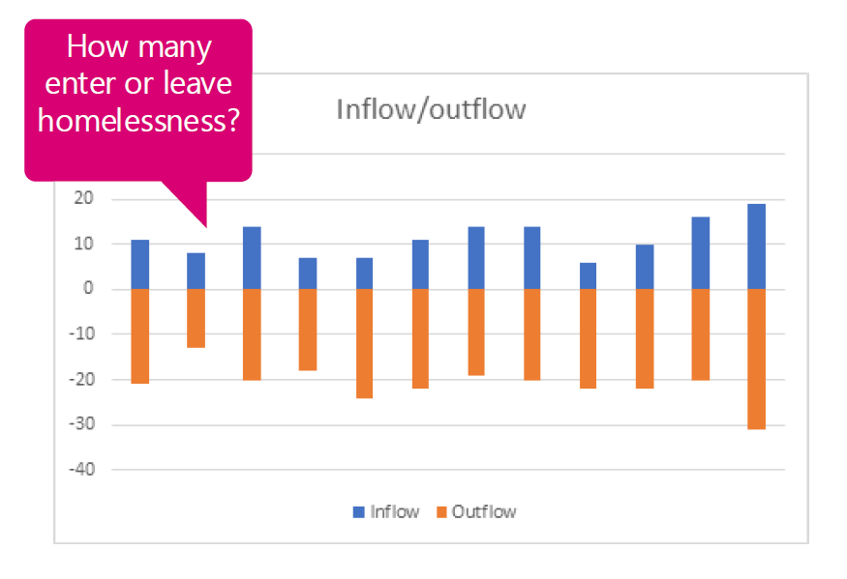
Example visualization – guiding insights

Slide 16
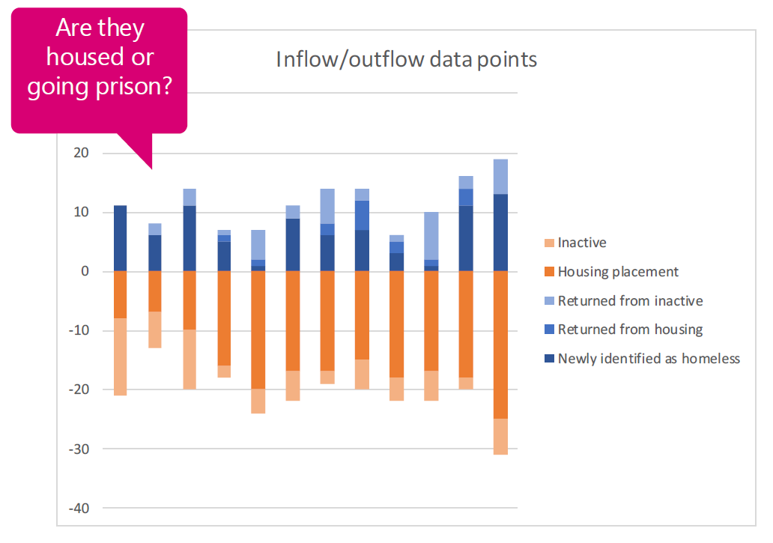
Example visualization – guiding insights

Slide 17
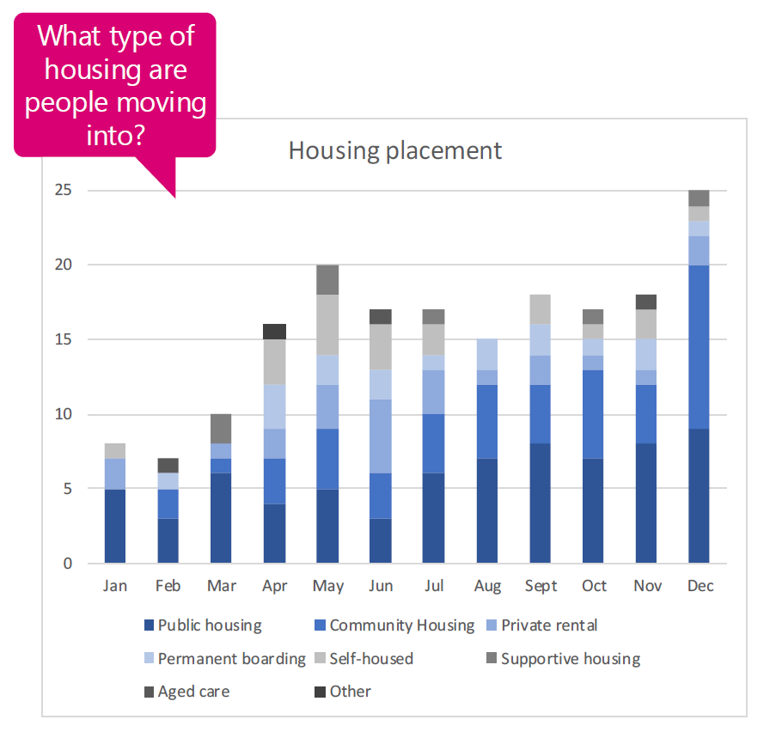
Example visualization – guiding insights

Slide 18
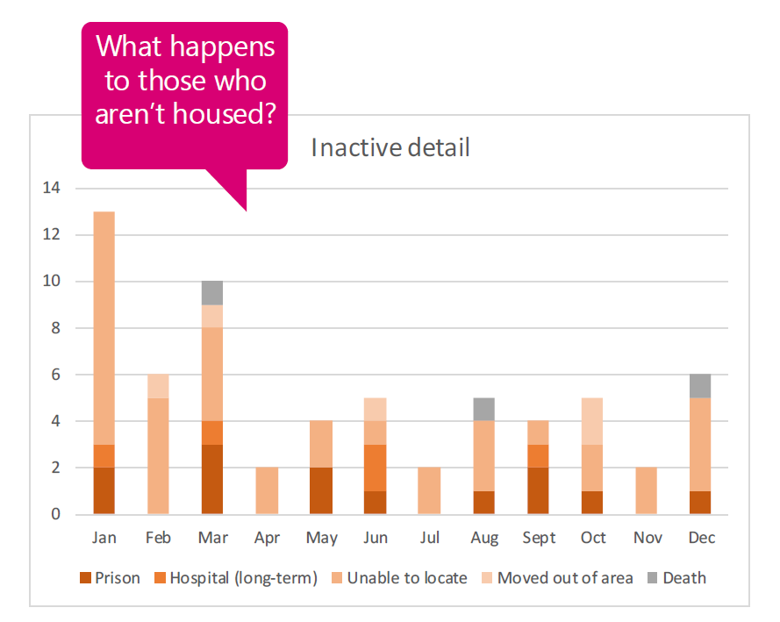
Example visualization – guiding insights

Slide 19
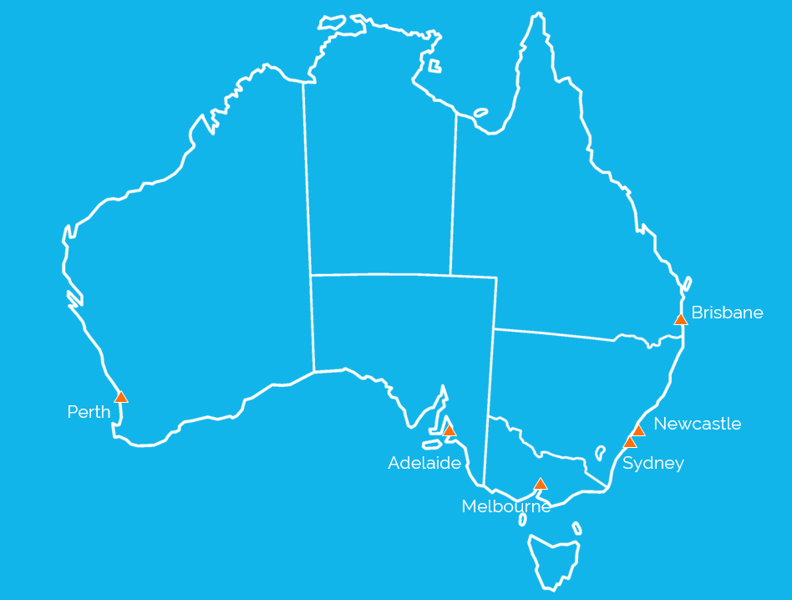
Australian Alliance to End Homelessness
We are part of something much larger
Perth: Ruah Community Services
Adelaide: Don Dunstan Foundation including NEAMI
Sydney: Mercy Foundation
Newcastle: St Vincent’s
Brisbane: Micah Projects
Melbourne: Launch Housing, Port Phillip Zero project
Community Solutions USA
Built for Zero

Slide 20
What it means to continue to get it wrong
Homelessness and mortality
People experiencing homelessness
Are many times more likely to die than the general population, with significantly higher risk of mortality
Die younger (up to 30 years)
These deaths are largely preventable if adequate housing and health supports are provided

Slide 21
Thank you

Slide 22
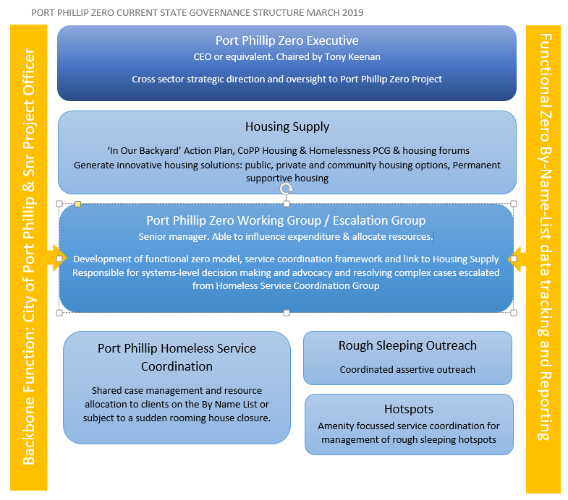
PP Zero: Governance Structure
Notes:
Mutually Reinforcing Activities now changed to identifying high value leverage points and possibly loose/tight working relationships: cooperation is not the be all and end all. CI participants must see beyond collaboration and instead focus on strategies that focus on “high leverage” opportunities for change. They must commit to a systemic reading of the complex systems they are trying to change, and to making a realistic assessment of where local actors have the knowledge, networks, and resources to make a difference.

Slide 23
Port Phillip Zero
Different roles (established)
PP Zero Executive
PP Zero Working Group / Escalation Group
PP Homeless Service Coordination
Rough Sleeping Outreach
Hot Spots
Community Lead (City of Port Phillip)
New roles
Data Lead (Launch Housing)

Slide 24
BNL: Create & Maintain and Work
Phase 1: Create the first list
Special session of rough sleeping outreach group
Pooling known people and adding to SRS
Phase 2: Maintaining and working the list
See handout for how to create first BNL and maintain it
CQI approach to the work: informed by the data, learning and reflecting as we go: system blockages and leverage points identified and responses tried, learnt from
Resources: to help maintain and share the list (LH)
Resources: for CQI (?)

