Slide 1
Consumer participation and feedback

Slide 2

My Experience
What I have learnt I don’t consider myself an expert
My background
Cat Mum

Slide 3
Purpose and benefits of consumer participation
Effective results come from engaging the people using the service to inform the service
Reduces the need to make assumptions
Honors the skill set and knowledge that comes from people with a lived experience
Positions the organization as a trustworthy service
Values and acknowledges lived experience as other forms of knowing outside of traditional education
Doesn’t reinforce power structures
Wider social change – empowering movements including ‘nothing about us without us’
Provides an opportunity for diverse perspectives
The process of engagement that occurs in consumer participation provides an opportunity to interact outside of the traditional ‘crisis’ only points of contact, greater insights, causation

Slide 4
What consumer participation has offered me
Tragic and painful past can be used to help others
Vocational space where I didn’t have to hide my past or pain instead be considered valuable and helpful
Helping others has been one big corner stone of my recovery- altruism is healing it breaks down isolation and shame
Seeing other people who were employed in LE roles created by effective Consumer Participation: hope e.g. meeting peer worker
Provided me with a pathway out ,allowed me to tap back into skills, hopes and strengths that I had disowned during traumatic life experiences

Slide 5
The LEAG: a form of effective consumer participation
Advisory group
Diverse membership
Set up with intention
Supported
Projects e.g. internal and external lived experience perspective talks, staff interview panels and planning, advocacy media opportunities, peer workers at Southbank

Slide 6
The LEAG and client Feedback
The LEAG reviewed the Launch Housing client feedback system
Edited the Feedback form: important key points that came from Lived Experience perspectives included: making sure it was plain language, visual symbols, included a statement that “we welcome your feedback, giving feedback not only helps you but the people who come after you”, making sure anonymity was an option, a clear statement that it will not affect the assistance you receive(safety)
Reviewed the processes and created purpose built feedback stations which were installed across four sites: the signage, the option to use a tablet, the wording of the questions
The LEAG also reviews de identified feedback and provides suggestions on areas of improvement, these suggestions are feed up the system and considered for future improvements
The fact that this is in place sends a clear message to service users that we value your feedback and that what you say matters. This helps cultivate a sense of trust and empowerment which is essential for facilitating meaningful authentic feedback.

Slide 7
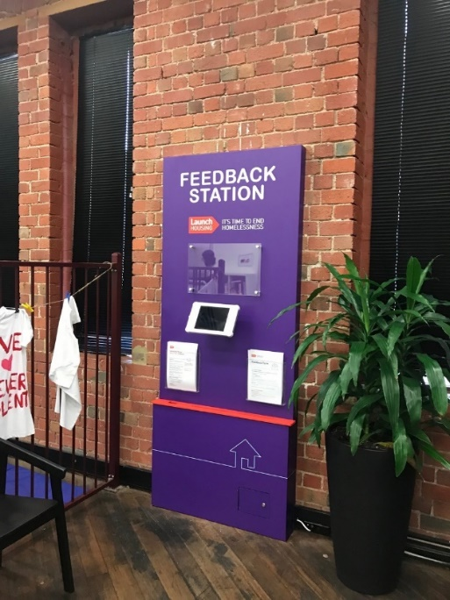
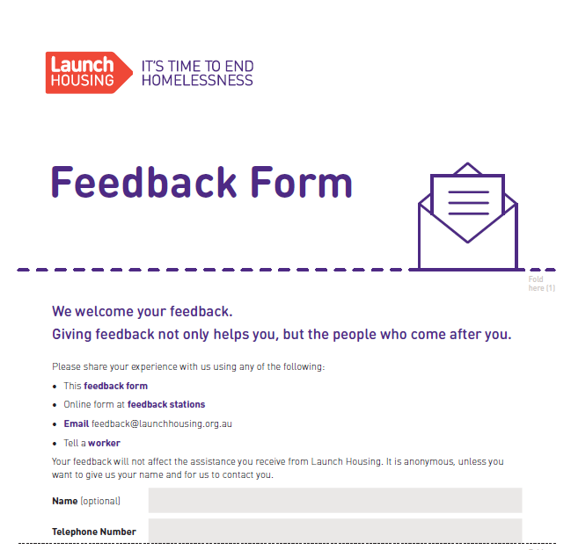

Slide 8
Helpful Resources
“Co-production Putting principles into practice in mental health contexts”Cath Roper / Flick Grey / Emma Cadogan
LEAG enquiries contact Claire.Coxon@launchhousing.org.au

